Slide 1
Extra pages
Week two

Slide 2
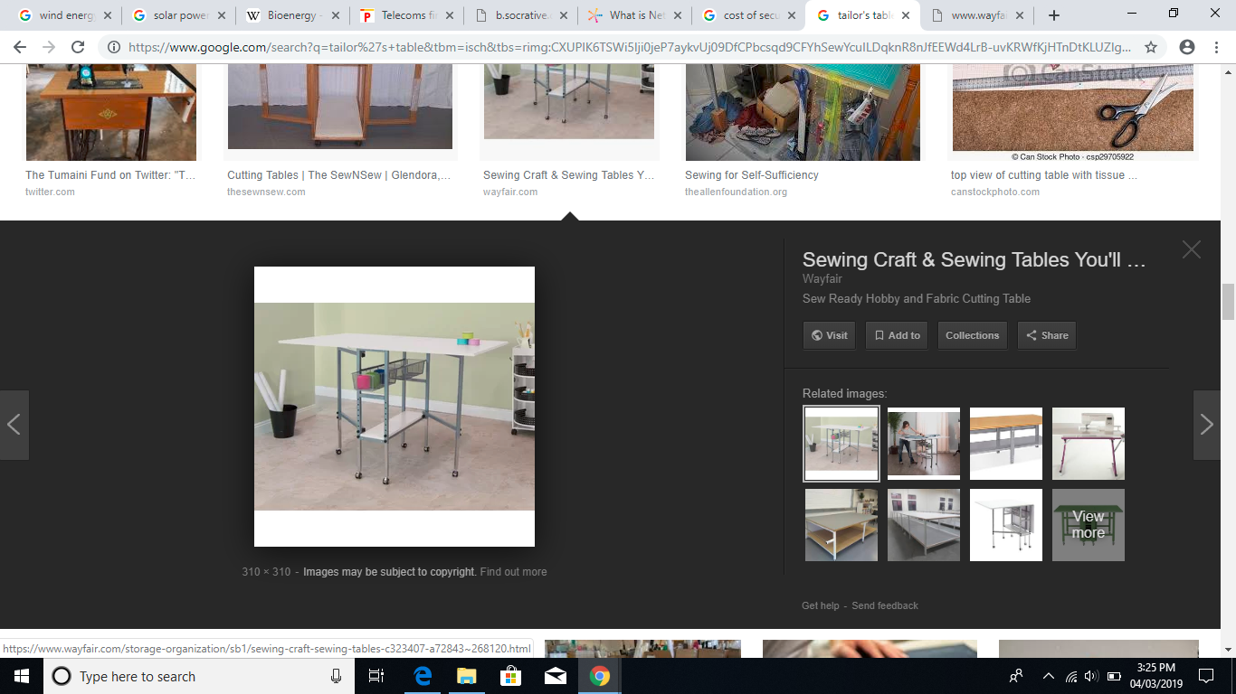
Tailor’s Table

Slide 3

Desiderata
Speak your truth quietly and clearly

